Slide 1

HealthScanAI: Dissect Medical Reports with AI
A Mini Project by
NEHA BITLA | (23106090)
DHAIRYA DIXIT | (23106108)
SHASHANK IYER | (23106056)
AYUSH DUBEY | (23106059)
Under the guidance of
Prof. Adesh Hardas
Academic Year 2025-26

Slide 2
Presentation Outline:
Introduction
Literature Survey of existing systems
Limitations in existing systems
Problem Statement
System Design & Workflow
Technologies & Methodologies
Implementation Screenshots
Conclusion
References

Slide 3
Introduction:
Medical reports play a crucial role in modern healthcare, helping doctors monitor health conditions and guide treatment decisions. However, these reports are often filled with technical terms and complex ranges that make them difficult for patients to interpret. This creates a communication gap—patients struggle to understand their results, while doctors face time constraints in explaining every detail. A Medical Report Analyzer bridges this gap by simplifying complex data into clear, personalized, and patient-friendly insights.
Medical reports are critical in modern healthcare.
Often filled with technical terms and complex ranges.
Patients struggle to interpret results without expert guidance.
Doctors face time constraints in explaining details.
This system provides simple, personalized insights.

Slide 4
Literature survey:
Title | Conference / Journal Details | Key Points | Improvements Proposed
Natural Language Processing of Lifestyle Modification Documentation | Health Informatics Journal, 2020 | Applies NLP to clinical text for identifying patient behaviors and health interventions; focuses on contextual classification | Use semantic and contextual classification to convert extracted report data into actionable medical insights
Exploring Current Practices and Challenges of HIPAA Compliance in Software Engineering: Scoping Review | IEEE Open Journal of Systems Engineering, 2024 | Reviews implementation of HIPAA compliance in healthcare software — encryption, role-based access, and audit trails | Integrate HIPAA-compliant encryption, audit logs, and access control for PHI handling within our system
Text Extraction from Images Using Tesseract | Deep Learning Techniques for Automation and Industrial Applications Wiley, 2024 | Details Tesseract OCR internals including preprocessing, thresholding, and skew correction for improved accuracy | Build a hybrid OCR pipeline that dynamically switches between native and Tesseract modes based on confidence scores
Simplifying Medical Report: A Novel Approach to Medical Reporting Using OCR Technology | 2025 | Introduces OCR-based conversion of medical reports into structured digital data; uses section segmentation and post-processing for error correction | Enhance layout analysis for complex, multi-format reports and integrate adaptive OCR correction with ML models

Slide 5
Limitations in existing systems:
Model Explainability – Patients may find AI-generated explanations difficult to trust without doctor validation.
Privacy & Security Risks – Handling sensitive health data requires strict compliance with privacy regulations.

Slide 6
Problem Statement:
Patients struggle to understand complex medical reports, and doctors lack time to explain every detail. Existing tools don't balance simplicity and accuracy, leaving a gap in clear interpretation. Create a system that automatically analyzes medical reports, highlights abnormalities, and provides personalized, easy-to-understand insights, especially in remote or resource-limited settings.

Slide 7
System Design:
User Input Handling:
  The system receives user input (either PDF medical reports or text-based symptoms) through a Flask/FastAPI API.
Text Extraction & Preprocessing:
  If a PDF is uploaded, text is extracted using PyPDF2 and Poppler.
  The raw text is then cleaned and standardized (using spaCy) for further analysis.
Disease Risk Assesment:
  The system uses pre-trained ML models (Logistic Regression, Random Forest, XGBoost) to predict potential diseases based on the extracted features
.
NLP-Based Analysis & Recommendations:
  Advanced NLP techniques (spaCy) are used for entity recognition and disease mapping, followed by generating personalized health recommendations and a health score.
Data Storage & Output:
  Results, user data, and reports are stored in an SQLite database; final predictions and recommendations are sent back to the user via the Flask API.

Slide 8
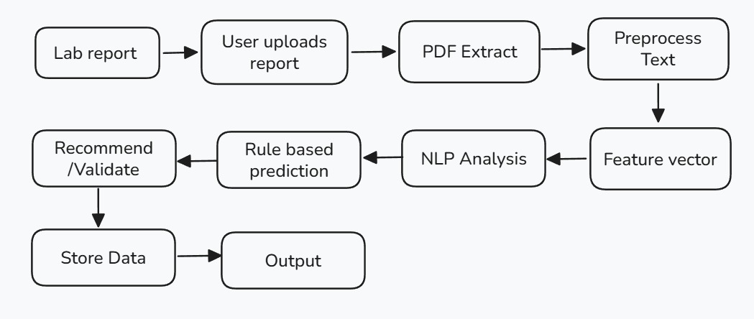
System Workflow:

Slide 9
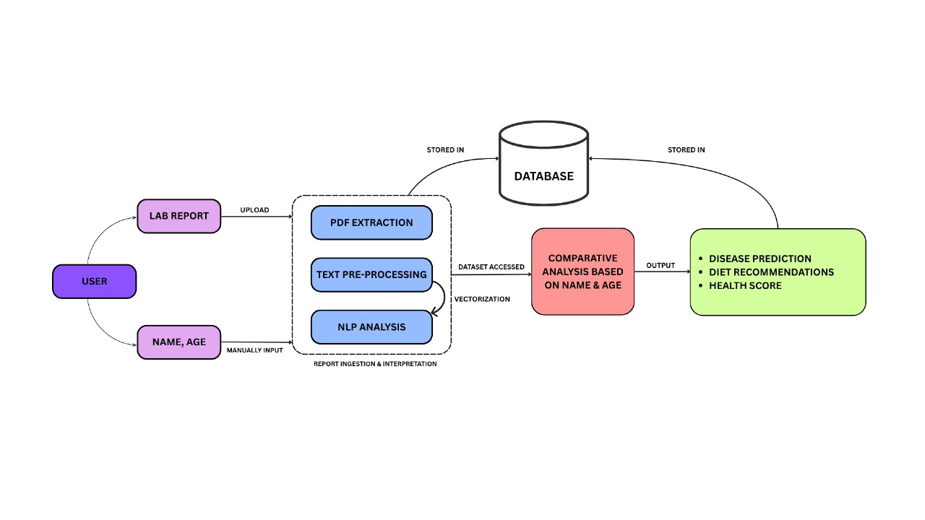
System Architecture:

Slide 10
Technologies & Methodologies:
Programming Language: Python
Backend: Flask / FastAPI
Machine Learning: scikit-learn, XGBoost
PDF Processing: PyPDF2, pdf2image, Poppler
Database: SQLite3
Storage: pickle
NLP: spaCy

Slide 11
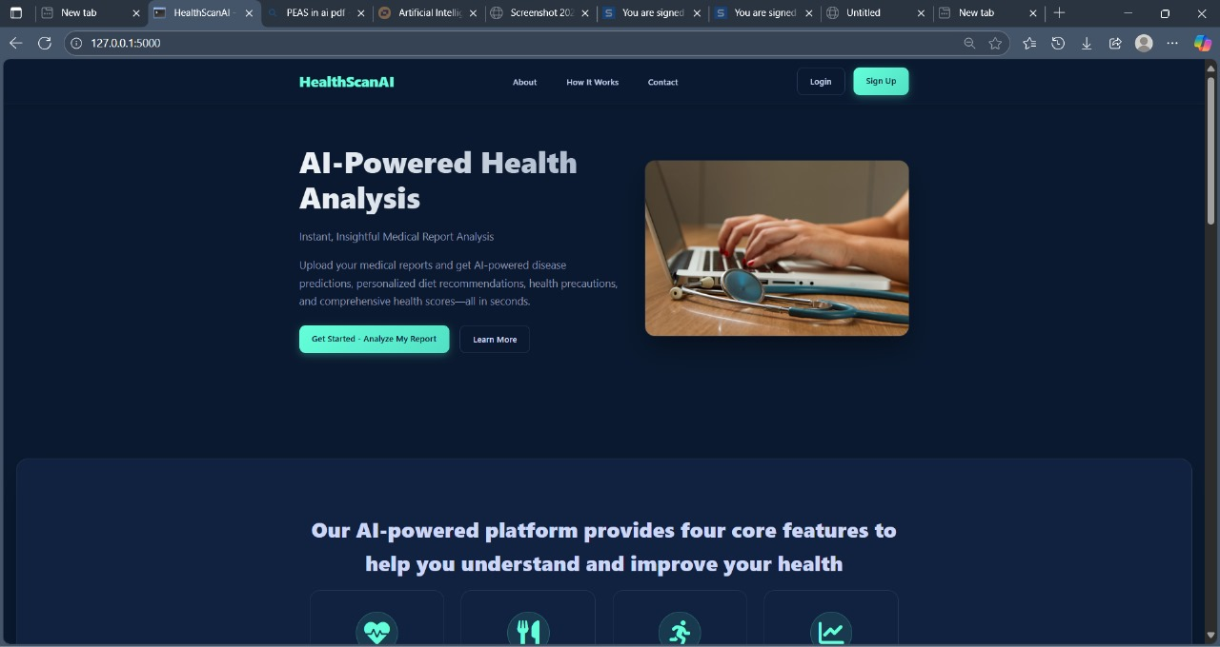
Implementation:
Landing Page

Slide 12
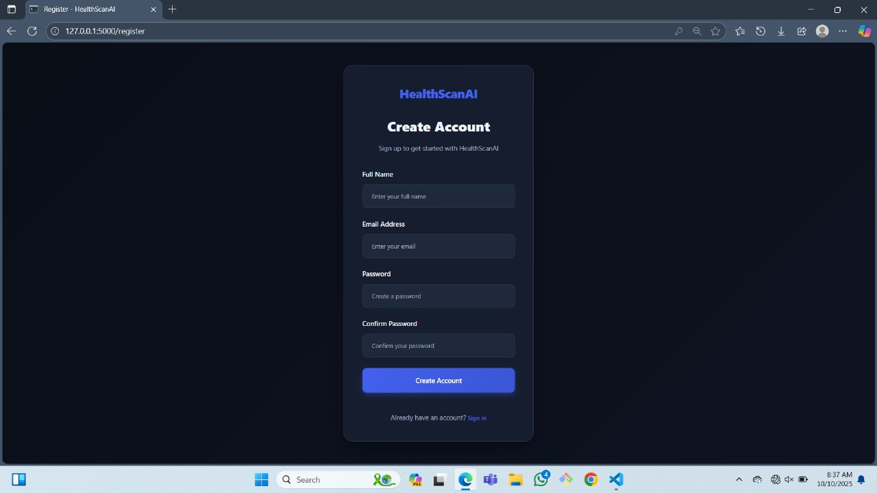
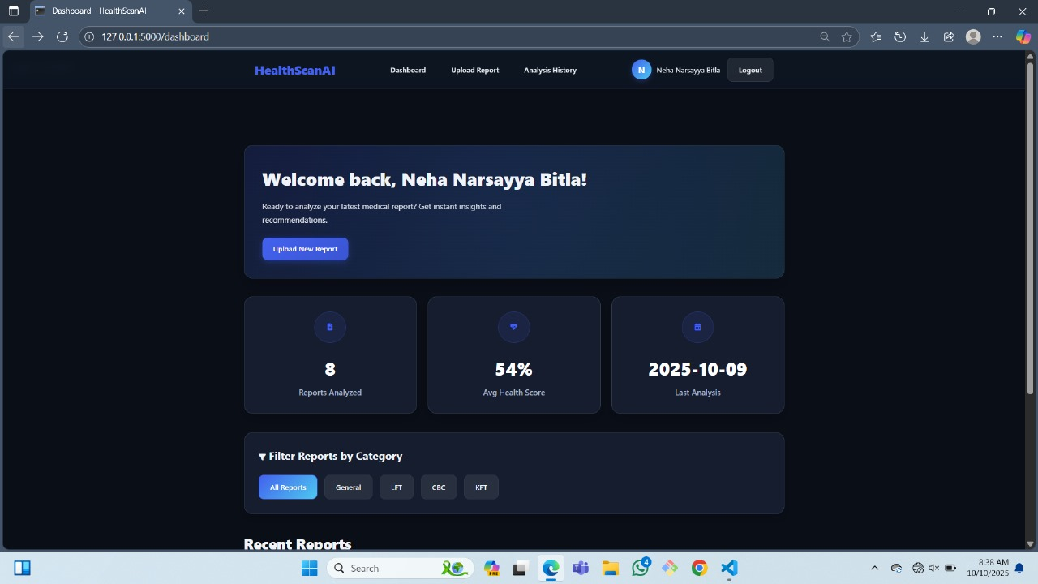
Implementation:
User Authentication Page

Slide 13
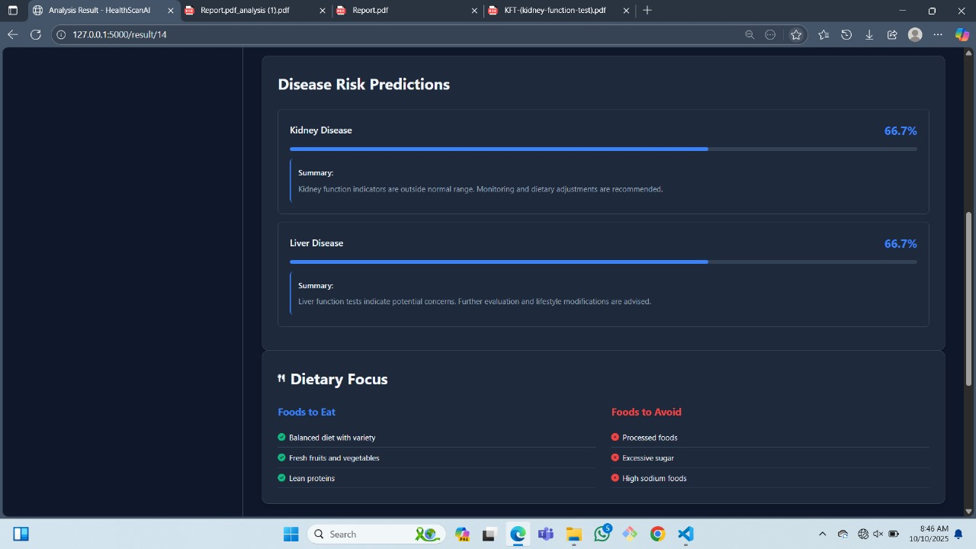
Implementation:
Result Page

Slide 14
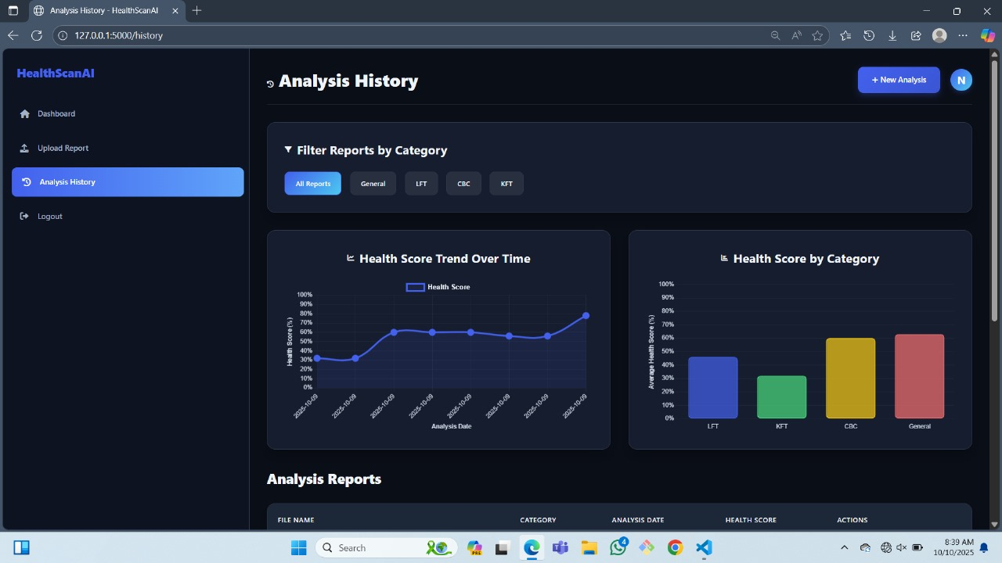
Implementation:
Analysis History

Slide 15
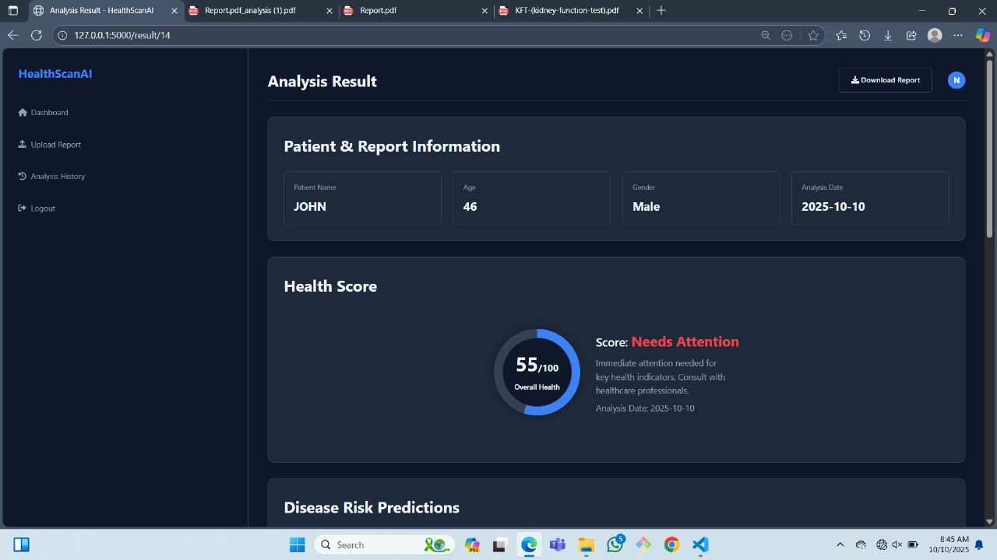
Implementation:
Final Analysis

Slide 16
Conclusion:
A Medical Report Analyzer makes healthcare more patient-centered.
Uses machine learning (ML) and natural language processing (NLP) to simplify complex medical reports.
Provides clear, accurate, and actionable insights for patients.
Improves health literacy, especially in remote or resource-limited settings.
Reduces the time burden on doctors by minimizing the need for detailed explanations.
Bridges the gap between medical expertise and patient understanding.
Contributes to enhanced patient care and improved health outcomes.

Slide 17
References:
https://github.com/chittipriya0010/medical-report-analyser/blob/main/app.py
https://youtu.be/MvfQq7E8X4Q?si=kz_6UMoxtArsOUr3
https://spacy.io/
Shoenbill K, Song Y, Gress L, Johnson H, Smith M, Mendonca EA. Natural language processing of lifestyle modification documentation. Health Informatics J. 2020
Santosh Kumar; Nilesh Kumar Sharma; Mridul Sharma; Nikita Agrawal, "Text Extraction from Images Using Tesseract," in Deep Learning Techniques for Automation and Industrial Applications , Wiley, 2024
F. Elkourdi, C. Wei, L. Xiao, Z. YU and O. Asan, "Exploring Current Practices and Challenges of HIPAA Compliance in Software Engineering: Scoping Review," in IEEE Open Journal of Systems Engineering, vol. 2, 2024
S. Sett and A. V. Singh, "Applying Natural Language Processing in Healthcare Using Data Science," 2024
R. Verma, S. Pandey, S. Awasthi and S. Shukla, "Simplifying Medical Report: A Novel Approach to Medical Reporting Using OCR Technology," 2025

Slide 18
THANK YOU!!

